Slide 1
Shepherding & Serving
牧養與服事
1 Peter 彼得前書

Slide 2
島嶼
不是陸地

Slide 3
WHICH ONE? (CIRCLE)
BE SERVED / SERVE
BE LOVED / LOVE
RECEIVE / GIVE
BE HELPED / HELP
TELL PEOPLE WHAT TO DO / DO IT.
LEAD / HELP OTHERS LEAD.
哪一個？（圈起來）
被服事/服事
被愛/去愛
接受/給予
被幫助/幫助
告訴別人該做什麼/ 自己去做
帶領/幫助他人帶領

Slide 4
1 Peter 5:2-5 “Be shepherds of God’s flock that is under your care, watching over them—not because you must, but because you are willing, as God wants you to be; not pursuing dishonest gain, but eager to serve; 3 not Lording it over those entrusted to you, but being examples to the flock.
彼得前書 5:2–5
2 務要牧養在你們中間神的群羊，按著神旨意照管他們；不是出於勉強，乃是出於甘心；也不是因為貪財，乃是出於樂意；3 也不是轄制所託付你們的，乃是作群羊的榜樣。

Slide 5
4 And when the Chief Shepherd appears, you will receive the crown of glory that will never fade away. 5 In the same way, you who are younger, submit yourselves to your elders. All of you, clothe yourselves with humility toward one another, because, “God opposes the proud but shows favor to the humble.”
SHEPHERD – SHEPHERDING.
4 到了牧長顯現的時候，你們必得那永不衰殘的榮耀冠冕。5 你們年幼的，也要順服年長的。就是你們眾人，也都要以謙卑束腰，彼此順服；因為「神阻擋驕傲的人，賜恩給謙卑的人」。
牧人 - 牧養

Slide 6
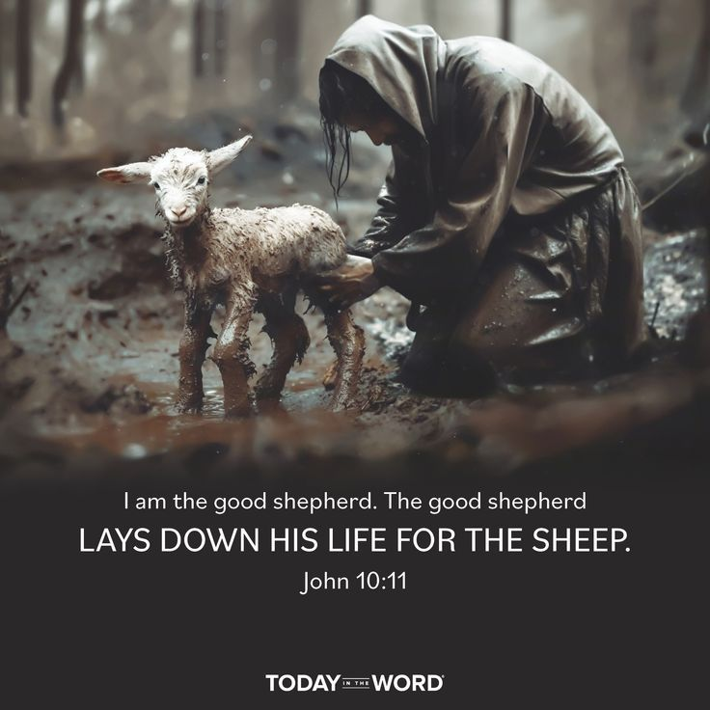
JESUS DESCRIBES HIMSELF AS A “SHEPHERD SERVANT”.
John 10:11 “I am the good shepherd. The good shepherd lays down his life for the sheep.”
MAIN QUALITY IS SACRIFICE
耶穌形容自己為「牧者僕人」
約翰福音 10:11 「我是好牧人；好牧人為羊捨命。」
主要特質是犧牲

Slide 7
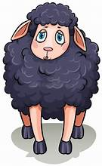
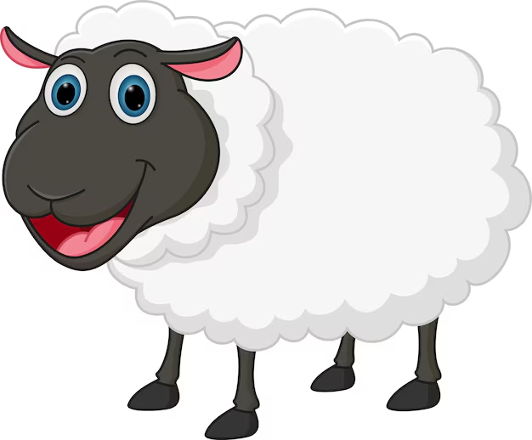
THE SHEEP PEN GETS WORSE IF JESUS SHEPHERDS ( YOU & ME) – SACRIFICE NOTHING - SERVE OURSELF
THE SHEEP PEN GETS BETTER IF JESUS SHEPHERDS (YOU & ME) – SACRIFICE OURSELF - SERVE OTHERS
羊圈會變得更糟:如果耶穌牧養（你和我）— 但我們不作犧牲，只為自己服務，
羊圈會變得更好:如果耶穌牧養（你和我）— 我們犧牲自己，服事他人

Slide 8
1 Peter 5:2-5 “Be shepherds of God’s flock that is under your care, watching over them—not because you must, but because you are willing, as God wants you to be; not pursuing dishonest gain, but eager to serve;
1ST QUALITY OF A SHEPHERD SERVANT
CARING (WATCHING OVER)
彼得前書 5:2-5
「務要牧養在你們中間神的群羊，按著神旨意照管他們；不是出於勉強，乃是出於甘心；也不是因為貪財，乃是出於樂意；
牧者僕人的第一個特質
關懷（照管）

Slide 9
1 Peter 5:2-5 “Be shepherds of God’s flock that is under your care, watching over them—not because you must, but because you are willing, as God wants you to be; not pursuing dishonest gain, but eager to serve;
2ND QUALITY OF A SHEPHERD SERVANT
SHEPHERD’S HEART – SERVING HEART
彼得前書 5:2-5
務要牧養在你們中間神的群羊，按著神旨意照管他們；不是出於勉強，乃是出於甘心；也不是因為貪財，乃是出於樂意；
牧者僕人的第二個特質
牧者的心 — 服事的心

Slide 10
1 PETER 5:3 not Lording it over those entrusted to you, but being examples to the flock.
3RD QUALITY OF A SHEPHERD SERVANT
NOT LORDING OVER
彼得前書 5:3
也不是轄制所託付你們的，乃是作群羊的榜樣。
牧者僕人的第三個特質
不轄制

Slide 11
Mark 10:42-45 42 Jesus called them together and said, “You know that those who are regarded as rulers of the Gentiles lord it over them, and their high officials exercise authority over them. 43 Not so with you. Instead, whoever wants to become great among you must be your servant, 44 and whoever wants to be first must be slave of all. 45 For even the Son of Man did not come to be served, but to serve, and to give his life as a ransom for many.”
馬可福音 10:42-45
42 耶穌叫他們來，對他們說：你們知道，外邦人有尊為君王的，治理他們，有大臣操權管束他們。
43只是在你們中間，不是這樣。你們中間，誰願為大，就必作你們的用人；
44在你們中間，誰願為首，就必作眾人的僕人。
45因為人子來，並不是要受人的服事，乃是要服事人，並且要捨命作多人的贖價。

Slide 12
1 PETER 5:3 not Lording it over those entrusted to you, but being examples to the flock.
4TH QUALITY OF A SHEPHERD SERVANT
BEING A SERVING EXAMPLE
彼得前書 5:3
也不是轄制所託付你們的，乃是作群羊的榜樣。
牧者僕人的第四個特質
作為服事的榜樣

Slide 13
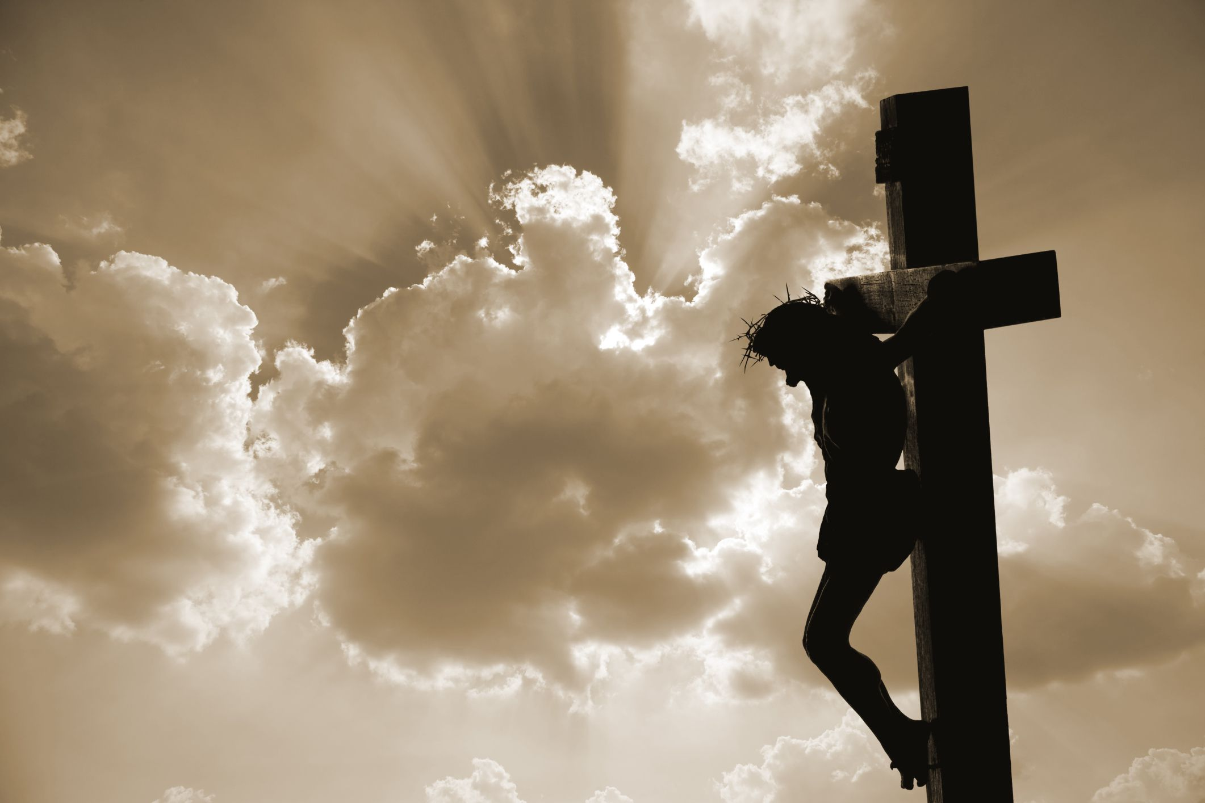
But God demonstrates his own love for us in this: While we were still sinners, Christ died for us. 惟有基督在我們還作罪人的時候為我們死，神的愛就在此向我們顯明了。ROMANS 羅馬書 5:8

Slide 14
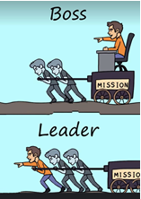
老板
領袖

Slide 15
1 Peter 5:5 All of you, clothe yourselves with humility toward one another, because, “God opposes the proud but shows favor to the humble.”
5TH QUALITY OF A SHEPHERD SERVANT
BEING HUMBLE
彼得前書5:5
你們年幼的，也要順服年長的。就是你們眾人，也都要以謙卑束腰，彼此順服；因為「神阻擋驕傲的人，賜恩給謙卑的人」。
牧者僕人的第五個特質
謙卑

Slide 16
REVIEW: QUALITIES OF A SHEPHERD SERVANT
CARING
SHEPHERD’S HEART – SERVING HEART
NOT LORDING OVER
BEING A SERVANT EXAMPLE
BEING HUMBLE
回顧：牧者僕人的特質
關懷
牧者的心 — 服事的心
不轄制
作為服事的榜樣
謙卑

